Slide 1
Channel Inc.
www.channellogin.com
• Setting the Standard for Loss Mitigation
• HAFA Compliant Short Sale Solutions
• Real Estate Technology Platform
• Agent Referral Program
• Agent Training Program

Slide 2
Agent Training Program
Custom Online Training Modules:
  Short Sale
  REO Asset Management
  BPO Process
  IRA Investor Relationship

Slide 3
Partnership & Vendor Structure
Channel Inc.
www.channellogin.com

Slide 4
Partnership & Vendor Structure
Channel Inc.
www.channellogin.com

Slide 5
Technology Solutions
Portfolio Management - Analytical services to assist in evaluating portfolio risks, needs, and preferred loss mitigation & short sale strategies.
Loss Mitigation Waterfall – Technology solutions to manage distressed assets from default through HAMP, HAFA and REO.
Broker Management – Agent network trained to reach out to homeowners improving execution and closing percentages.
On Line Offer Management – High traffic marketing exposure and on-line sealed bids increase execution rates and sales prices of short sale listings.
Customization – Technology platform which is fully customizable to meet the growing needs of the servicer, special servicer or business process outsource firm.
Vendor Management – Order placement, tracking and reporting are all managed from the centralized platform.
End to end solution for servicers loss mitigation needs. Full outsource with custom features to suit your every need.

Slide 6
Reactive and Proactive Campaigns
Reactive Campaigns
Consumers attempt to initiate loss mitigation process
  Borrower gets a contract on their property
  Servicer must react to determine if it is even eligible for a short sale and must determine if it can be sold and how
  The Buyer backs out due to the lengthy process and confusion
Realtors submit short sales ad hoc
  Packages are inconsistent, incomplete or illegible
  Constant drain on call centers and loss mitigation departments
  Strain on HAFA compliance
HAFA compliant system oriented process
  Loss mitigation teams have total control on the process
  Technology driven automation eases work load on staff
  Predictable metrics enable sound budgeting and allocation of assets
Stratify distressed borrowers by degree- work smarter not harder by grouping distressed borrowers in tiers that support your internal policies and procedures.
  HAMP eligible
  NON-HAMP eligible
  Analysis of junior liens to determine closing probabilities
Target your high risk current customers - Option Arms, 100% CLTV, Stated Income, Declining markets, etc. and find out who is already listing their property. Work with them now.
Unpredictable and a costly drain on your resources, this is an obsolete business model for today’s fast paced environment.
Proactive Campaigns
Using state of the art technology and best practices is the SMART solution to your loss mitigation needs.
Lender/Servicers work proactively with the borrower to properly package the property for sale. The result – the property gets SOLD!

Slide 7
Loss Mitigation
Analytics – Analytical modules to assist in evaluating portfolio risks, needs, and preferred loss mitigation & short sale strategies.
Data & Contact Management – Every player in the loss mitigation arena may be managed within a single file including vendor management, email communications, and conversation logs
Loan Modification – HAMP (and NON-HAMP) waterfall process is easily adhered to within the workflow. File status and tasking are all pre-set to ensure users at all levels stay on task within each file.
Short Sales – HAFA compliant and a natural progression from the HAMP process makes Channel Inc. the state of the art in loss mitigation technology and business process outsourcing.
REO Asset Management – The final stop in loss mitigation is seamlessly integrated into the Channel Inc. platform.
Today Servicers need to be prepared to manage a distress asset from the point of default through the entire loss mitigation waterfall.

Slide 8
Loss Mitigation Technology Process Flow
HIGH RISK LOAN CAMPAIGN

Slide 9
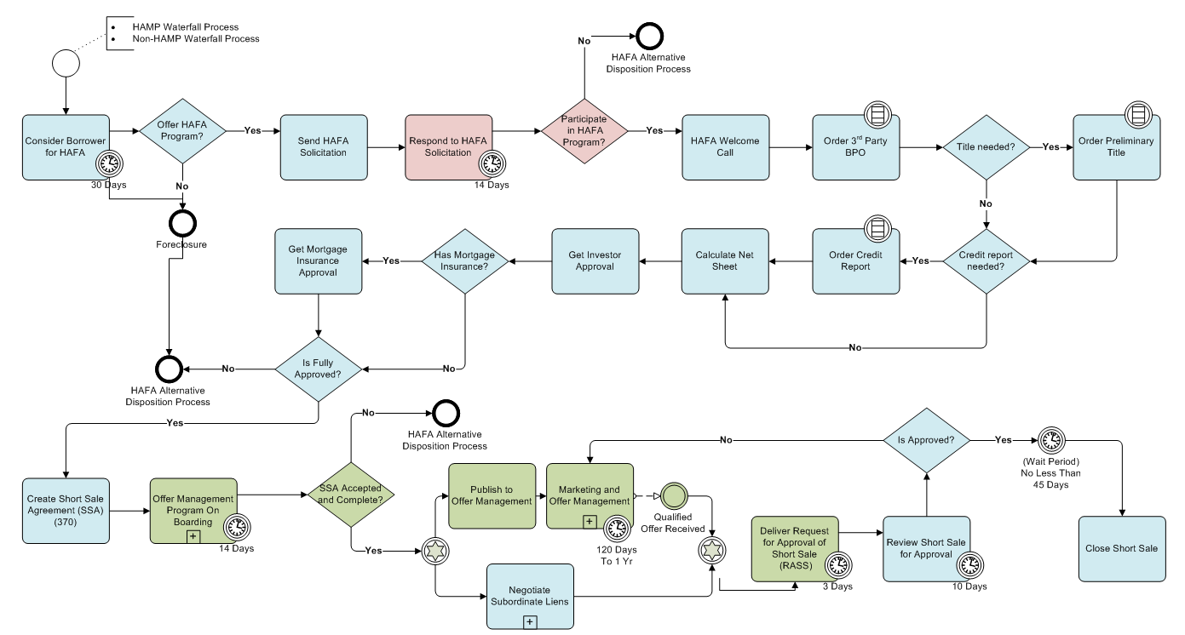
HAFA Compliant Workflow

Slide 10
HAFA Compliance
Workflow – Workflow based process management system is customized to adhere to HAFA guidelines and timetables.
Integration – All aspects of the Channel Inc. platform are seamlessly integrated into the process minimizing down time and the need for multiple platforms
Document management – HAFA documents (SSA, RASS and ARASS) are all pre-populated within the platform with data entered in the workflow process.
Reporting – HAFA data fields required in the monthly reporting to Fannie Mae are maintained for ease in reporting and tracking.
Customization – As guidelines change with the times, so is your ability to modify any or all aspects of the workflow, process and reporting mechanisms.
April 5, 2010 marks the date that the Home Affordable Foreclosure Alternative (HAFA) program goes into effect. Servicers who are participating in the HAFA program will need to be fully compliant.

Slide 11
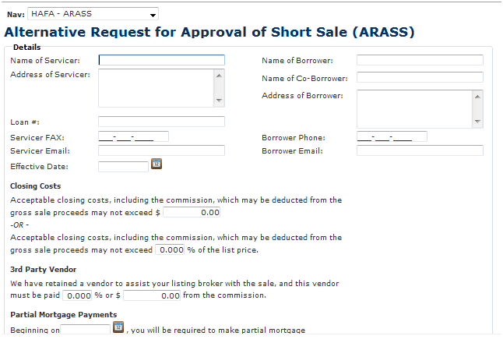
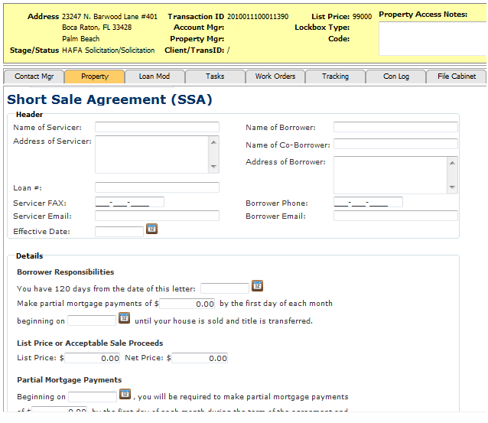
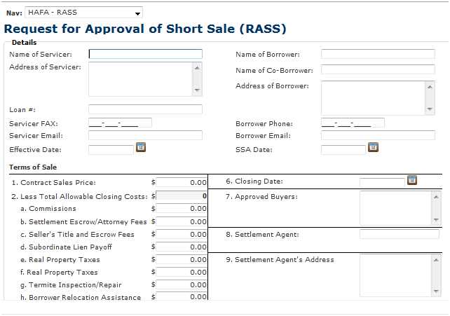
HAFA Documents

Slide 12
High Touch Workflow Solutions
Proactive Communication – Reach out to home owners while there is still time to work out a viable solution.
FDCPA Compliant Debt Collectors – Fully compliant to safeguard your assets.
Licensed Agents – Specifically trained in HAMP and HAFA guidelines.
Increase your operational efficiency – 24/7 customer service availability, on-line reporting.
Reduce the risk of foreclosure – Message blast to drive response, multi-channel communication, follow up after direct mail campaigns.
Channel Inc. has partnerships and relationships with the industry’s most trusted service providers.
If you want a fully scalable solution to meet the ebb and flow of the current financial climate, outsourcing your call center can be one major advantage to your bottom line.

Slide 13
Negotiating Junior Liens
Outsourced Negotiation Teams - Fully scalable to meet your needs, we have affiliations with industry professionals with proven track records.
HAFA Compliance – Seamless integration into your existing process, this addresses the one major obstacle in the HAFA program.
NON-HAFA short sales – An essential part of your short sale waterfall process will be converting to traditional short sales. Negotiating judgments and recovery notes is vital to the success of this process.
Leverage – A higher degree of industry experience than most loss mitigation staff gives the Primary Lien holder more leverage in the negotiation process.
Between 50-70% of distressed assets have subordinate liens which can adversely impact the success of your HAFA short sale transactions.

Slide 14
Agent Referral Program
Channel Inc.
www.channellogin.com
Short Sale Referrals
REO Referrals
IRA Investor Referrals
Investor Referrals

