Slide 1
The Landscape of
REO
Asset Management

Slide 2
Current REO Asset Management
ASSET MANAGER
LISTING AGENT
BUYERS AGENT
BUYERS AGENT
ASSISTANT
ASSISTANT
SERVICE VENDOR selected by agent
SERVICE VENDOR selected by agent
SERVICE VENDOR selected by agent
SERVICE VENDOR selected by agent
SERVICE VENDOR selected by agent

Slide 3
Current REO Asset Management The Big Picture
ASSET MANAGER
ASSET MANAGER
ASSET MANAGER
ASSET MANAGER
LISTING AGENT
LISTING AGENT
LISTING AGENT
LISTING AGENT
LISTING AGENT
LISTING AGENT
LISTING AGENT
LISTING AGENT
LISTING AGENT
LISTING AGENT
LISTING AGENT
LISTING AGENT
ASST
ASST
ASST
ASST
ASST
ASST
ASST
ASST
ASST
ASST
ASST
ASST
M U L T I P L E 1 0 0’s o f P R O P E R T I E S P E R A G E N T
SERVICE
VENDORS
SERVICE
VENDORS
SERVICE
VENDORS
SERVICE
VENDORS
SERVICE
VENDORS
SERVICE
VENDORS
SERVICE
VENDORS
SERVICE
VENDORS
SERVICE
VENDORS
SERVICE
VENDORS
SERVICE
VENDORS
SERVICE
VENDORS

Slide 4
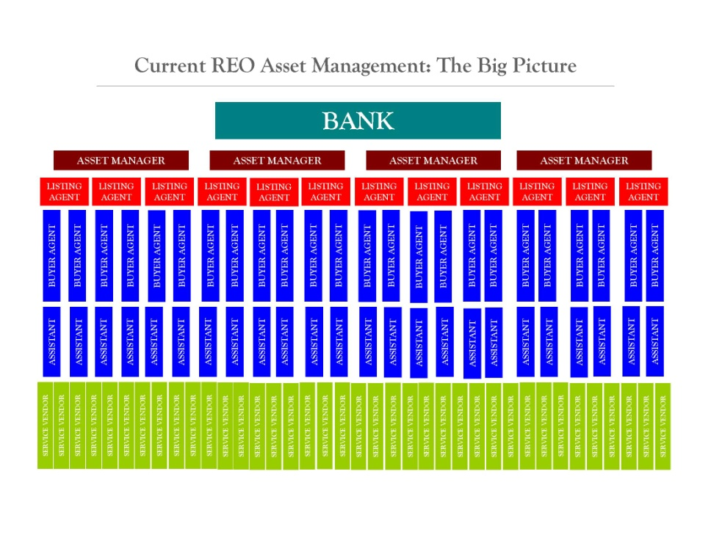
Current REO Asset Management The Bigger Picture

Slide 5
Current REO Asset Management Listing Agent Point of View
High Commission Listing Agent
Asset Manager
Asset Manager
Hundreds of Listings
Asset Manager
Asset Manager

Slide 6
Regional Real Estate Firm
Regional Real Estate Firm
Regional Real Estate Firm
Regional Real Estate Firm
Regional Real Estate Firms
Bank Client
National
Portfolio
Management
Company

Slide 7
Portfolio Asset Manager
Company REO Dept.
LICENSED & CERTIFIED VENDORS
CERTIFIED LISTING AGENTS
CERTIFIED BUYER AGENTS
SUPPORT STAFF

Slide 8
Benefit to Asset Management
Single point of contact
REO certified Listing Agents
REO certified Buyer Agents
Seasoned REO Coach
“Managed” Property Management
Managed Lead Capture and re-marketing

Slide 9
REO Department Responsibility
Management of the property re-key
Utility activation / management
Vendor services management
Homeowner associations / liens
Emergency repairs
Property inspections
Bi-weekly billing of all services & utilities

Slide 10
Certified Listing Agent responsibility
Occupancy check
Cash for keys
Eviction
Vendor box
BPO
Property marketing
Property inspections
Monthly reports

Slide 11
Lead Management System
In-bound Call Capture
Appointment made and agent assigned
Buyer Orientation
Lender Contact & appointment
:
Continued re-marketing contact
Continued agent contact
:
Buyer buys property

