Slide 1
Real Estate Owned
What is the problem
Who shares in the problem
Solution

Slide 2
REO Predicament
Unprecedented volume of properties
Low value return on properties sold
Properties sell Wholesale not Retail
Time on market is costly
Drain on resources to manage the process

Slide 3
Who Feels the Pain?
Note holders
Buying Consumer
Communities
Realtor Listing Agents
Realtor Buyer Agents
Realty Companies

Slide 4
Note Holders
Not Maximizing return on properties
System designed for a few REOs
Selling Wholesale, not RETAIL
Time on Market is costly
Accidently in the property business
Over loaded Asset Managers
Over loaded Legal & Processing system

Slide 5
REO Asset Managers
Inefficient use of time and resources
Growing collection of properties to manage
Oversee hundreds of listing agents
Have no validation process for agents
Have little control over what agents actually do

Slide 6
Listing Agent Realtors
Overloaded with properties
Limited personal capital
Overwhelmed with Buyer agent calls
Overwhelming consumer/buyers calls
Making less net income
Forced to manage, hire, train agents
Forced to manage, hire, train staff

Slide 7
Listing Agent Realtors
Many are finding creative solutions
Cutting corners on rehabilitation
Cutting quality of maintenance
Don’t answer Coop broker calls
Don’t answer consumer inquiries
Pushing them to their own investors
Double-Dipping to increase income
Notes:
Many have hundreds of properties
Story about the lawn next door to demonstrate how they manage not having enough capital
Story about not turning on the utilities to save money for over a year.
Mike’s two-phone story demonstrates how they handle consumers and coop brokers

Slide 8
Realtor Buyer Agents
Offers not considered in timely way
Can’t get information from Listing agent
Limited understanding of REO process
Limited access to REO home buyers
No communication with Asset Manager
Avoid showing REO properties

Slide 9
Realty Companies
Legal responsibility for listings
Lack control of Listing Agents
Lack control of assignments to agents
Lost income from ignored buyer calls
No agent accountability with leads
After-sale liability with buyers

Slide 10
Home-Buying Consumers
Lack access to buying bargain property
Don’t know new listing availability
Lack financial ability to repair properties
Need “good” financing options
Unaware of unique lending programs

Slide 11
Communities
Plummeting Property Tax base
Deteriorating neighborhoods
Health and safety issues
Some are levying fines on properties
Crime in and against vacant properties

Slide 12
Problem is Complex
There is no simple solution
Communication needs to be simple
Human interface needs to be simple
Accountability must be built in
Must be Scalable to High Volume
Everyone must win

Slide 13
Solution
Simplified Interaction among:
Note Holders
Interested consumers
Real Estate Firms
REO Websites
Buyer-side Agents

Slide 14
Solution
Reporting on:
Properties
Offer Processing
REO-Interested Buyers
Listing & Buyer Agents
Marketing efforts

Slide 15
REO Buyers Management
Inbound Call Center handles initial call
Information entered into database
Referred to approved mortgage/lender
Referred to Buyer Agent
Activities Reported to Database
Re-market every appropriate new listing
Buyer agent & Lender report activities

Slide 16
Marketing Properties
Sign number goes to Call Care Center
Property maintained by company REO dept
Assigned to Certified Listing Agent
Entered in MLS, downstream websites, etc
Emailed to existing leads

Slide 17
Realtor Accountability
No “Double-Dipping”
Agents are assigned only after certification
Supervision by REO Dept
All activities are reported and monitored
All leads are monitored
Leads are re-marketed automatically
Results are monitored

Slide 18
Asset Manager Efficiency
One-to-One relationships with REO directors
Offers are reported directly to the system
Results are reported to the system
Asset managers access property reports
Management monitors activities and results

Slide 19
Real Estate Firms
Management reporting
Property rehabilitation reports
Control of rehabilitation work
Fiscal Controls and reporting
Agent effectiveness comparison reports
Control of who is assigned to properties

Slide 20
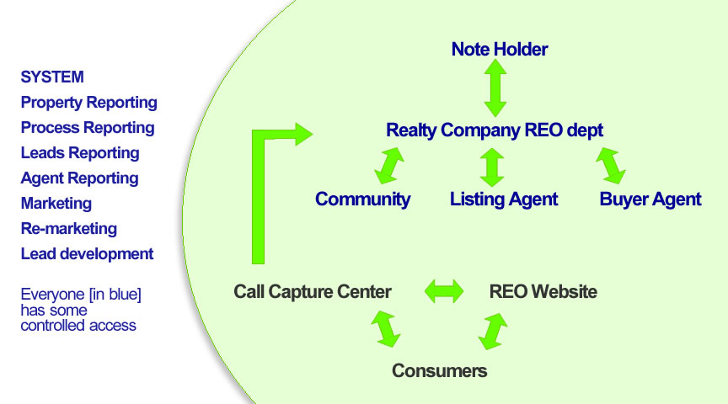
Solution

Slide 21
Who are we?
Quantum REO Solutions [QuREOs, Inc.]:
Quantum Management Systems
Strong, independent regional Companies
Inbound Call Care Center

Slide 22
Quantum Management
For over 30 years:
Real estate training systems
Business Consulting
Real estate agent productivity programs
Scientific Marketing system for real estate
Agent accountability systems

Slide 23
David Boxall
Head Asset Management for Wells Fargo
Systems Analysis

Slide 24
Strong Local Regional Firms
Phoenix: Russ Lyons Sotheby’s
Chicago: Baird & Warner
So. California: Prudential California
No. California: Intero Real Estate
South Florida: Keyes Real Estate,
Las Vegas: Coldwell Banker Premier
Georgia: Prudential
Texas: Dallas Fort Worth: Winans GMAC
San Antonio: CB D’Ann Harper
Austin, Houston E. Texas: CB United
Minnesota, Wisconsin: Edina Realty
Michigan: Surovell Realty, Southern Greenridge Realty, Western
Utah: Coldwell Banker
Denver: Fuller Sotheby’s

Slide 25
Discussion
Questions
Getting Started
When

